Slide 1

Uipath
Guru S. Anand
gurusanand@gmail.com

Slide 3
Cash Forecasting
“Treasury forecasting is still a cumbersome, manual, and spreadsheet-based process involving many people from across the organization, resulting in monthly or quarterly, rather than weekly, updates,” said PwC in its report.
According to the survey results, 53% of the respondents are still only updating cash flow forecasts monthly; 23% update them quarterly; and 15% update them weekly.
Forecast horizons vary: 27% forecast the current budget year, 25% the current quarter, and 19% the current month. Almost a quarter of respondents (22%) use a 12-month rolling forecast.
Concerns over the accuracy of forecasts may be related to the granularity of inputs. Most companies “have forecasting reports only at a consolidated level using monthly input numbers at the transaction type level,” explains PwC. “Less than 6% of the respondents make use of the inputs at the transactional level.”
Notes:
http://ww2.cfo.com/cash-flow/2017/02/cash-flow-forecasting-still-vexing/

Slide 4
Applications
“The bank accounts not visible are typically stand-alone accounts with local banks for which only local management has access,” says PwC. Not only are these accounts issues for forecasting purposes, says PwC, but “without visibility on balances and transactions, these accounts are potential targets for fraud and cyber criminality.”
For many companies, this problem won’t go away soon. On average, organizations are maintaining relationships with 7.7 core banks and 20.7 additional banks. They also have an average of 344 bank accounts with local banks.
“While more treasurers than ever before are fully controlling bank relationships across the enterprise,” says PwC, one-third of the survey respondents indicated they had no formal process in place related to bank relationships or that treasury had only a “passive role” in them.
Notes:
http://ww2.cfo.com/cash-flow/2017/02/cash-flow-forecasting-still-vexing/

Slide 5
Applications
PwC’s latest global treasury benchmarking report, reveals that the success of the treasury profession is dependent on how well it operates in an increasingly virtual environment.
PwC’s report The ‘virtual reality’ of treasury​ captures the views of over 220 treasurers and Chief Financial Officers (CFOs) from around the world and shows that only one third of people involved in treasury processes today report directly to the treasurer. Increased outsourcing of back office and payment factory processes and more involvement with local finance teams for exposure reporting create new complexities in implementing regulations, safeguarding liquidity and managing risks.
Commenting on the findings, Sebastian di Paola, Global Corporate Treasury Leader at PwC, says:
“Treasury’s scope continues to expand and should be seen very much as a process rather than a department. Treasury is becoming increasingly virtual and treasurers need to be jacks of all trades by collaborating more with the business, shared services and banks and raising their game in IT security, valuation and financial risk management. As a result, traditional management models may not be as effective as in the past. Instead, a consultative approach, better integration with other business processes and automation will generally be the best strategy.”
Key findings include:
The agendas of the treasurer and the CFO should be better aligned
Although the agendas of the CFO and the treasurer are aligned at a high level, CFOs are urging treasurers to take on responsibilities beyond the textbook definition of treasury, opening up opportunities for treasurers. However, treasurers do not appear to have the same sense of urgency as CFOs on topics like cybersecurity, compliance, working capital and financial risk management, as CFOs mention these 2-3 times more often as top priorities than treasurers do.
True focus on cash flow forecasting is needed
Cash flow forecasting is at the top of the treasury agenda for both CFOs and treasurers. More than 40% of the respondents mention this as a priority and 80% of these people rank it as high or of critical importance. However, there are a number of basic issues that need resolution, including accuracy of data, data mapping and proper tooling, before treasurers can truly benefit from the features that enable proper predictive and scenario analysis.
Treasurers need to take action to safeguard assets with rising cybersecurity threats
Treasury typically ‘owns’ payment infrastructures and bank communication. Both are key business functions and cannot be compromised. With cyber attacks and payment fraud regularly making headlines, treasurers must be vigilant in safeguarding financial assets. It is worrying, therefore, that only 19% of treasurers list cybersecurity as a critical concern. By contrast, 45% of CFOs name cybersecurity as a priority, pointing to a significant misalignment in CFO and treasury agendas in this regard.
Notes:
https://press.pwc.com/News-releases/a-new--virtual-reality--is-creating-profound-implications-for-treasury-processes--technology-and-the/s/f73b9516-c2d5-4aee-99da-6fea5e171fe7

Slide 6
Variables
We need a place to store some information . To store the data, so that the data could be used for the entire program.

Slide 7
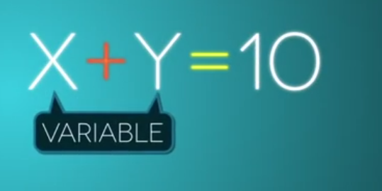
Questions?
A variable is nothing but a name given to a storage area that our programs can manipulate.

Slide 8
Questions?
Function
Sub
Operator
Get
Set
RaiseError
The constants refer to fixed values that the program may not alter during its execution. These fixed values are also called literals.

Slide 9
Questions?
The modifiers are keywords added with any programming element to give some especial emphasis on how the programming element will behave or will be accessed in the program.
For example, the access modifiers: Public, Private, Protected, Friend, Protected Friend, etc., indicate the access level of a programming element like a variable, constant, enumeration or a class.
Private | Specifies that one or more declared programming elements are accessible only from within their declaration context, including from within any contained types.
Public | Specifies that one or more declared programming elements have no access restrictions.

Slide 10
Properties and Methods
Properties and Methods

Slide 11
Date
The Date data type contains date values, time values, or date and time values. The default value of Date is 0:00:00 (midnight) on January 1, 0001. The equivalent .NET data type is System.DateTime.
The DateTime structure represents an instant in time, typically expressed as a date and time of day

Slide 12
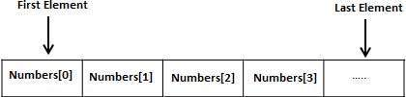
Array
An array stores a fixed-size sequential collection of elements of the same type. An array is used to store a collection of data, but it is often more useful to think of an array as a collection of variables of the same type.
All arrays consist of contiguous memory locations. The lowest address corresponds to the first element and the highest address to the last element.

Slide 13
Array
A procedure is a group of statements that together perform a task when called. After the procedure is executed, the control returns to the statement calling the procedure.

Slide 14
Questions?
Object - Objects have states and behaviors. Example: A dog has states - color, name, breed as well as behaviors - wagging, barking, eating, etc. An object is an instance of a class.
Class - A class can be defined as a template/blueprint that describes the behaviors/states that objects of its type support.
Methods - A method is basically a behavior. A class can contain many methods. It is in methods where the logics are written, data is manipulated and all the actions are executed.

Slide 15
Questions?
Data Type | Storage Allocation | Value Range
Boolean | Depends on implementing platform | True or False
Byte | 1 byte | 0 through 255 (unsigned)
Char | 2 bytes | 0 through 65535 (unsigned)
Date | 8 bytes | 0:00:00 (midnight) on January 1, 0001 through 11:59:59 PM on December 31, 9999
Decimal | 16 bytes | 0 through +/-79,228,162,514,264,337,593,543,950,335 (+/-7.9...E+28) with no decimal point; 0 through +/-7.9228162514264337593543950335 with 28 places to the right of the decimal
Double | 8 bytes | -1.79769313486231570E+308 through -4.94065645841246544E-324, for negative values
Integer | 4 bytes | -2,147,483,648 through 2,147,483,647 (signed)
Long | 8 bytes | -9,223,372,036,854,775,808 through 9,223,372,036,854,775,807(signed)
Object | 4 bytes on 32-bit platform | Any type can be stored in a variable of type Object
 | 8 bytes on 64-bit platform
SByte | 1 byte | -128 through 127 (signed)
Short | 2 bytes | -32,768 through 32,767 (signed)
Single | 4 bytes | -3.4028235E+38 through -1.401298E-45 for negative values;
 |  | 1.401298E-45 through 3.4028235E+38 for positive values
String | Depends on implementing platform | 0 to approximately 2 billion Unicode characters
UInteger | 4 bytes | 0 through 4,294,967,295 (unsigned)
ULong | 8 bytes | 0 through 18,446,744,073,709,551,615 (unsigned)
User-Defined | Depends on implementing platform | Each member of the structure has a range determined by its data type and independent of the ranges of the other members
UShort | 2 bytes | 0 through 65,535 (unsigned)

Slide 16
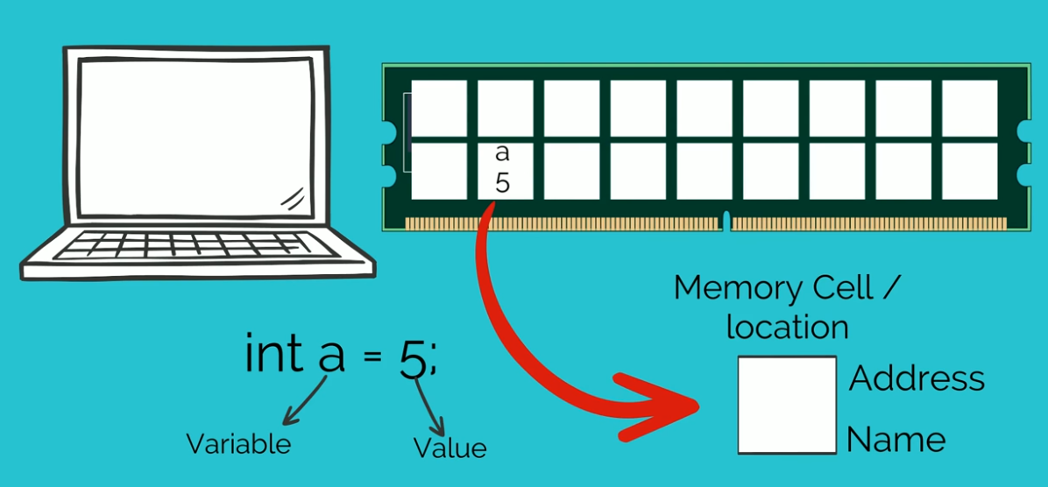
Questions?

Slide 17
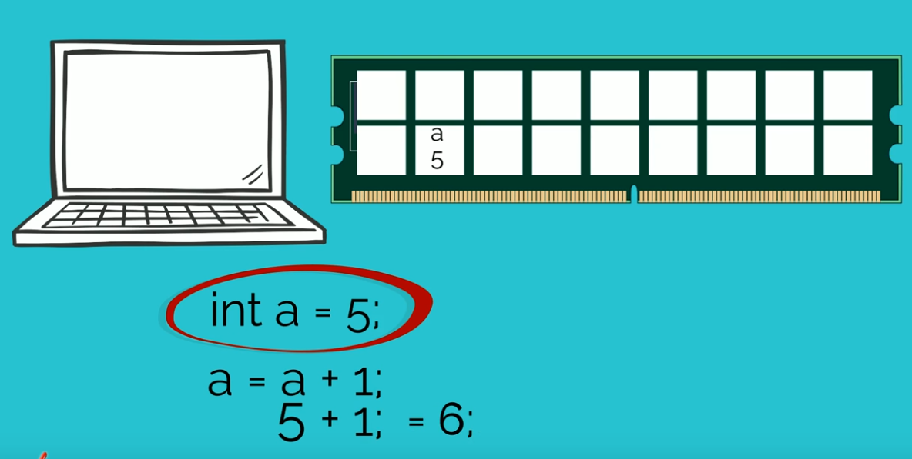
Questions?

Slide 18
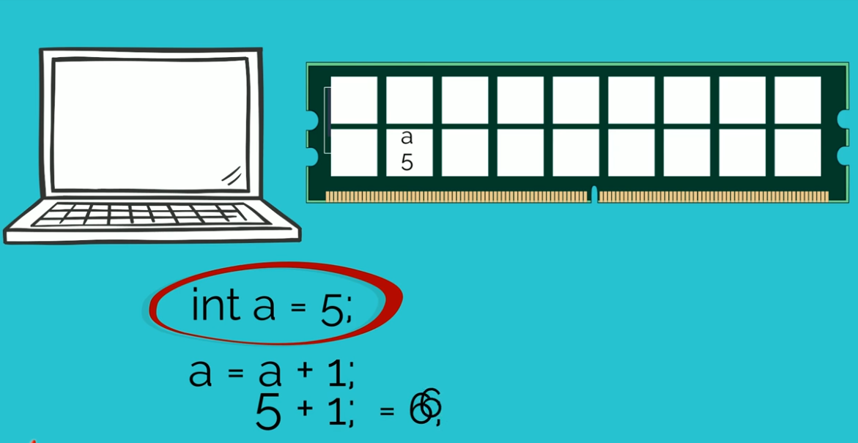
Questions?

Slide 19
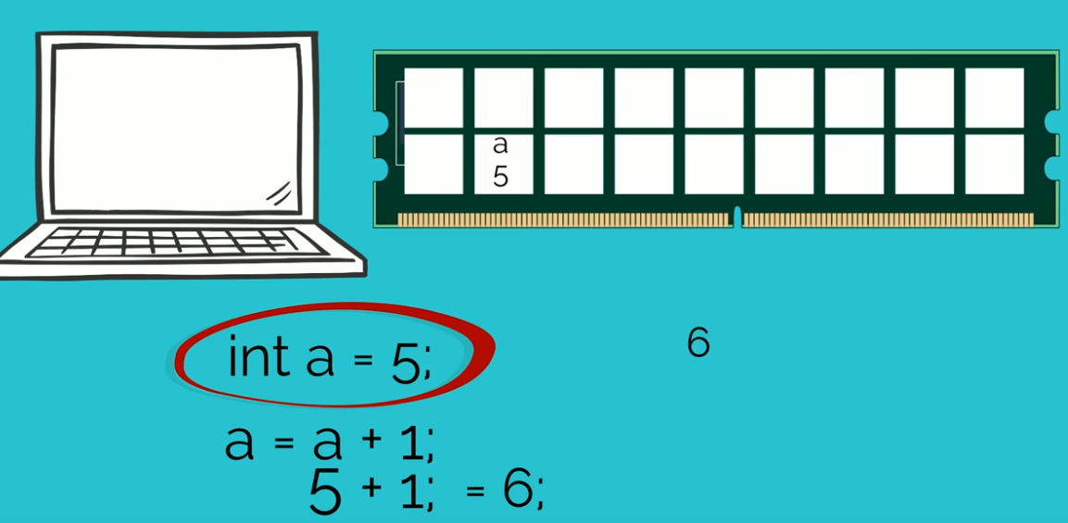
Questions?

Slide 20
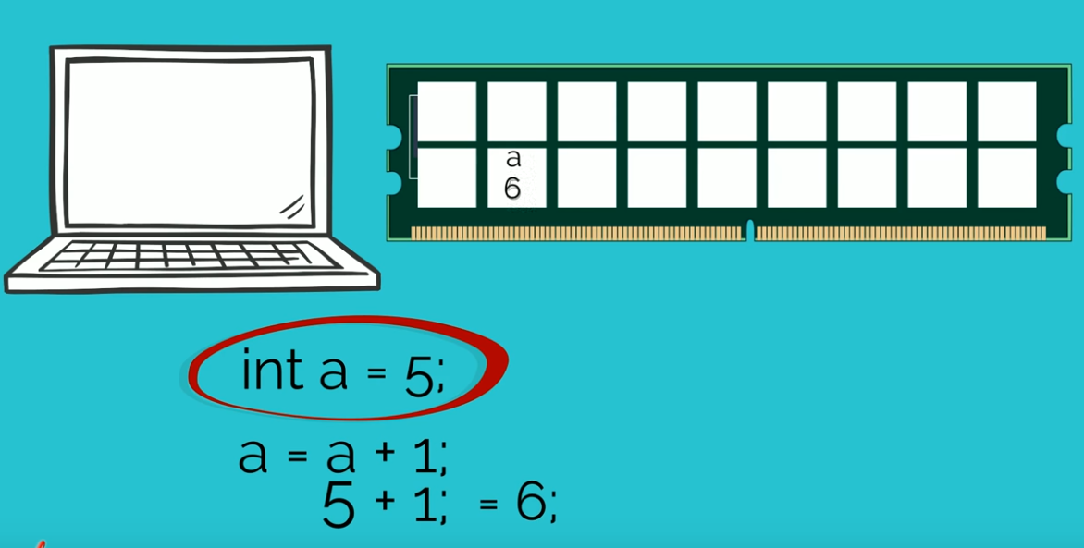
Questions?

Slide 21
Questions?

Slide 22
Thank You

Slide 23
Questions?

